Slide 1
SSc Methylation 验证选点
2015/12/21

Slide 2
Hypermethylated genes
Related to the organization of nuclear: BRDT
Related to oxidative stress: DDO
Related to glucose metabolism in liver and adipose tissue: FAM132A, SLC35E2(nuclear sugar)
regulaton of the inflammation in fat tissue: FAM132A, TLR1
Related to presenting antigen: HLA-DQA2
lncRNA: LOC90784
mRNA regulatory element: MGC87042
Related to mitotic cell cycle progression: NEK7
a transcriptional coactivator: PRIC285
Related to adipose and energy metabolism: PRKAG2
Regulation of stromal metabolism: SDF4
urea transport: SLC14A1
TGF betal signaling: SMAD3
Related to IFN I signaling: TLR1
the innate immune response to microbial agents: TLR1, HLA-DQA2, LOC90784(autoimmune)
Related to the protein degradation: UBR3
zinc finger transcription factor: UBR3, ZNF257

Slide 3
Hypomethylated genes
Associated with autoantibody production: CCDC85C, ZBTB46
Related to Innate immunology: COLEC11, EIF2AK2, IFITM1, FKBP5, IFI44L, RSAD2
Related to cytochrome c oxidase：COX7A2
Related to protein folding and export: DNAJC17, FKBP5, HOOK2
Related to viral infection: EIF2AK2, IFITM1, IFI44L, MX1, RSAD2(HCMV infection), ZBTB46
Related to IFN I signaling: EIF2AK2, IFITM1, IFI44L, MX1, RSAD2, ZBTB46
Related to sphingolipid metabolism: ARSD
bone and cartilage matrix: ARSD
Related to glucose metabolism: GFPT2, RPTOR
Related to the organization of centrosome:HOOK2
Related to inflammatory and autoimmune diseases: IL17RA, UPK3B
zinc finger transcription factor: PRDM16, TRIM27(gene transcription)
Related to adipose and energy metabolism: PRDM16
Related to the replication of DNA: PRIM2
Regulation of vasculogenesis and angiogenesis: RADIL
control of cellular proliferation and differentiation: RASA3
Regulation of joint function: RNF39
Related to Nutrient matabolism: RPTOR
Related to Kidney function: UPK3B

Slide 4
BRDT (bromodomain testis-specific gene)
Testis-specific chromatin protein that specifically binds histone H4 acetylated at Lys-5 and Lys-8 (H4K5ac and H4K8ac, respectively) and plays a key role in spermatogenesis
Required for chromocenter organization
RNA splicing
PAPER: Expression of cancer-testis antigens in lung cancer: definition of bromodomain testis-specific gene (BRDT) as a new CT gene, CT9.

Slide 5
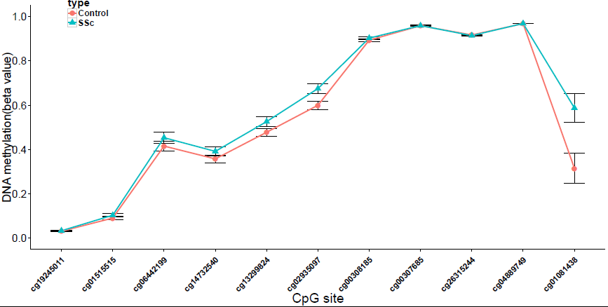
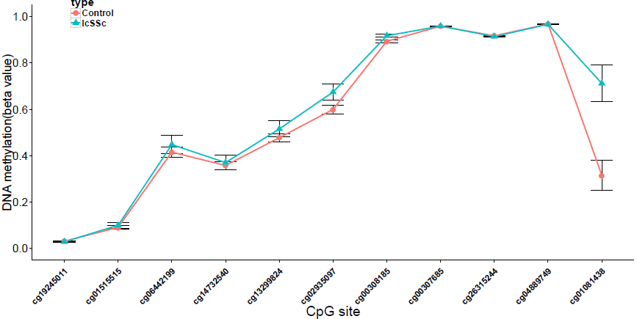
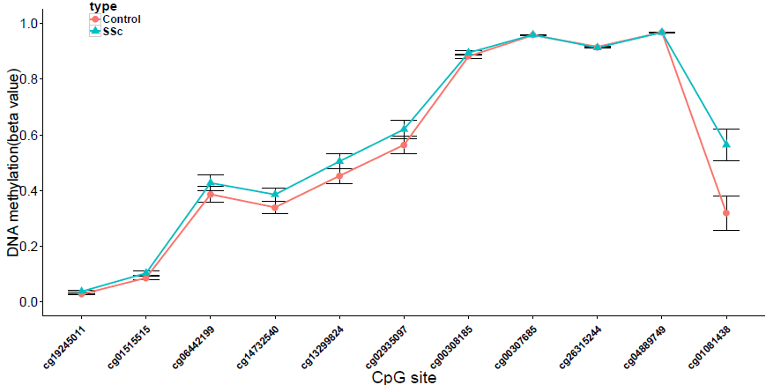
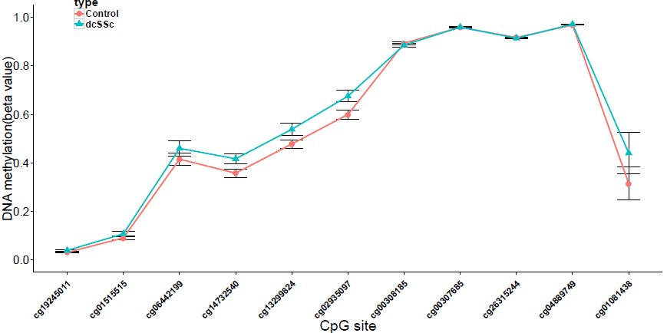
CD4 Total
CD4 lcSSc vs. Control
CD8 Total
CD4 dcSSc vs. Control

Slide 6
DDO (D-Aspartate Oxidase)
a peroxisomal flavoprotein that catalyzes the oxidative deamination of D-aspartate and N-methyl D-aspartate. Flavin adenine dinucleotide or 6-hydroxyflavin adenine dinucleotide can serve as the cofactor in this reaction.
Among its related pathways are Peroxisome and Alanine, aspartate and glutamate metabolism. GO annotations related to this gene include receptor binding and D-amino-acid oxidase activity.
Notes:
oxidative stress

Slide 7
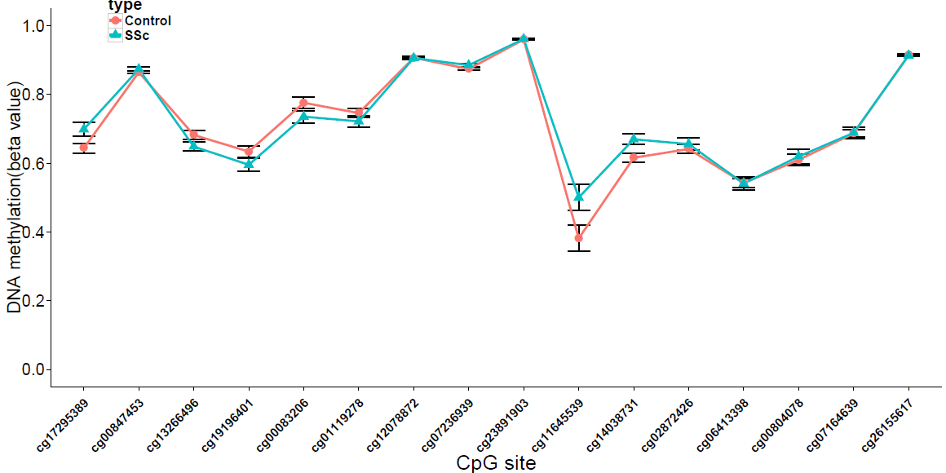
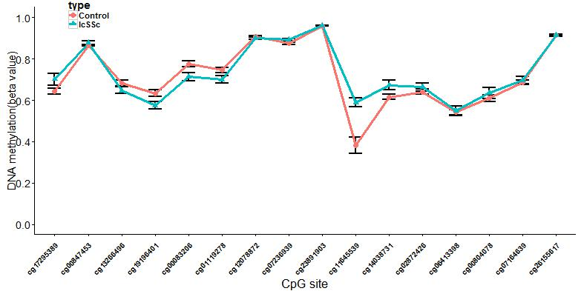
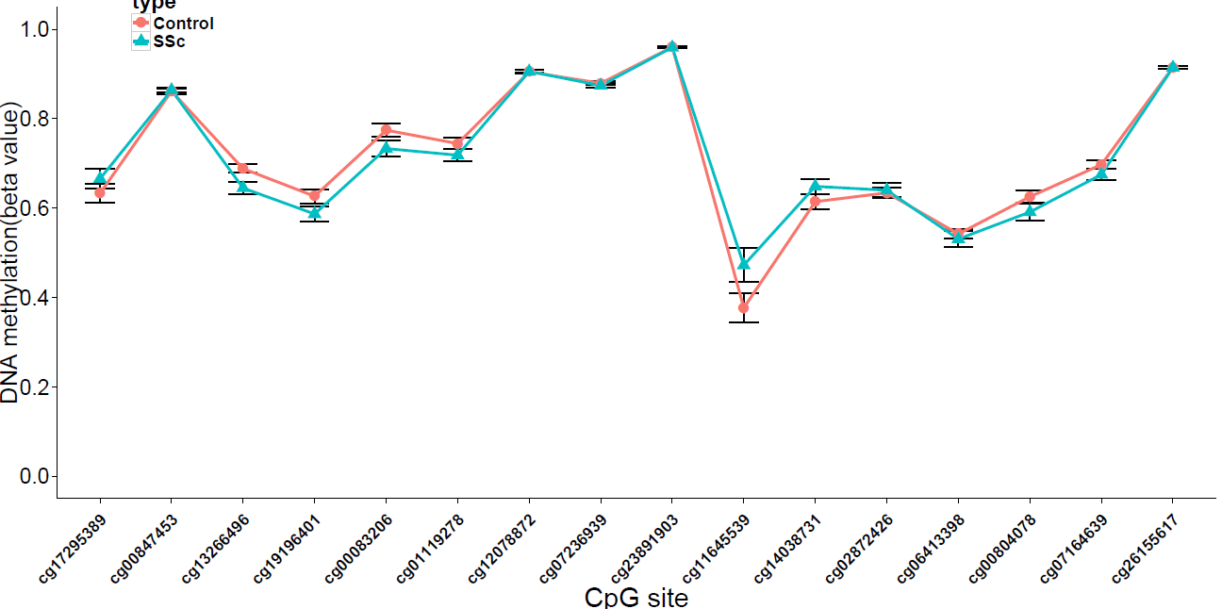
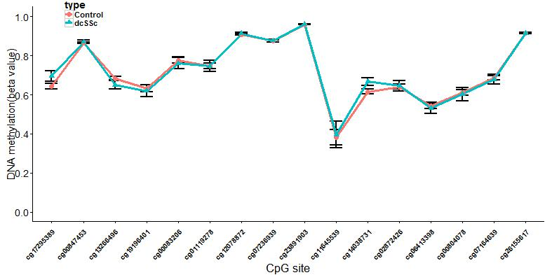
CD4 Total
CD4 lcSSc vs. Control
CD8 Total
CD4 dcSSc vs. Control

Slide 8
FAM132A (Family With Sequence Similarity 132, Member A)
Insulin-sensitizing adipocyte-secreted protein (adipokine) that regulates glucose metabolism in liver and adipose tissue.
Promotes glucose uptake in adipocytes and suppresses de novo glucose production in hepatocytes via the PI3K-Akt signaling pathway.
Administration lead to reduction of blood glucose.
Able to attenuate inflammation in fat tissue (By similarity)

Slide 9
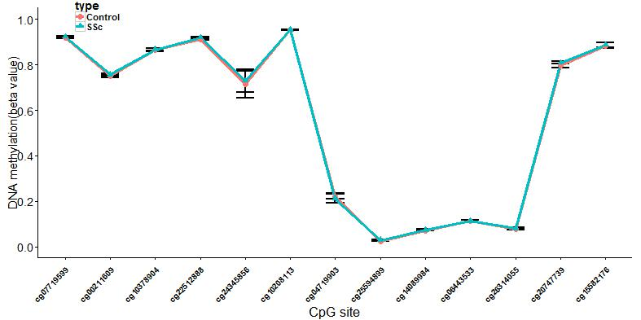
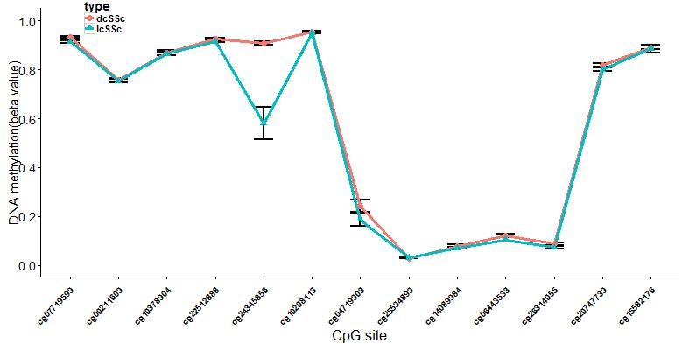

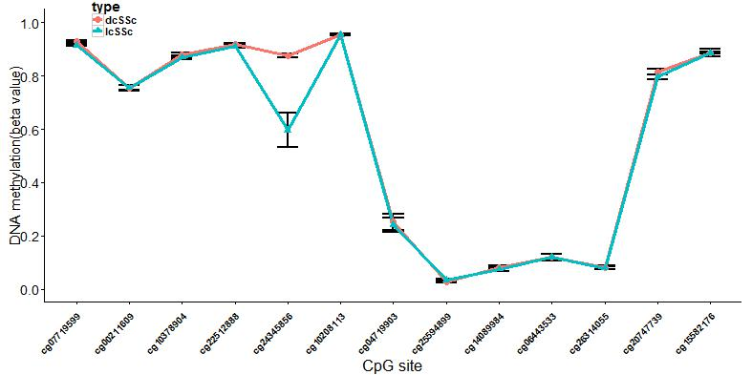
CD4 Total
CD4 dcSSc vs. lcSSc
CD8 Total
CD8 dcSSc vs. lcSSc

Slide 10
HLA-DQA2 (HLA Class II Histocompatibility Antigen, DQ(6) Alpha Chain)
the HLA class II alpha chain family. The encoded protein forms a heterodimer with a class II beta chain.
It is located in intracellular vesicles and plays a central role in the peptide loading of MHC class II molecules by helping to release the CLIP molecule from the peptide binding site.
Diseases associated with HLA-DQA2 include hiv-1. Among its related pathways areClass I MHC mediated antigen processing and presentation and GPCR Pathway.
Notes:
Class II molecules are expressed in antigen presenting cells (B lymphocytes, dendritic cells, macrophages) and are used to present antigenic peptides on the cell surface to be recognized by CD4 T-cells.

Slide 11
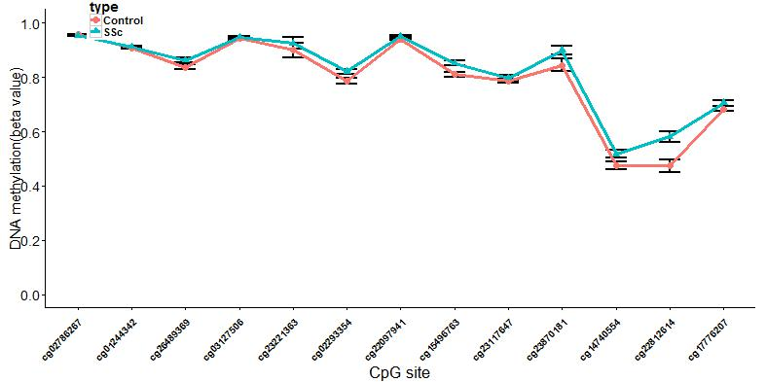
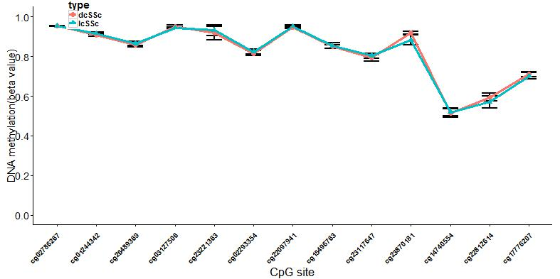
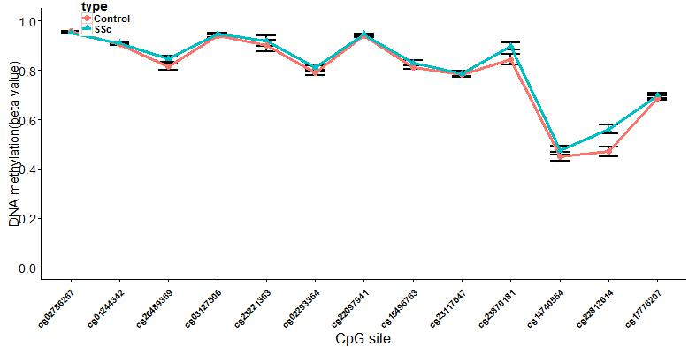
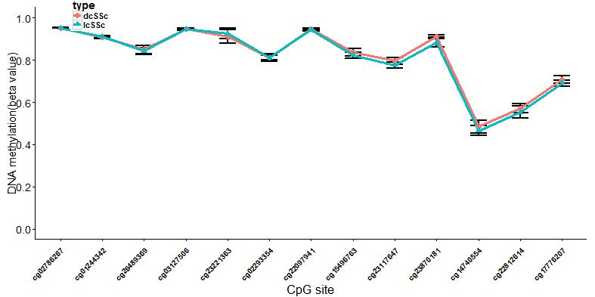
CD4 Total
CD4 dcSSc vs. lcSSc
CD8 Total
CD8 dcSSc vs. lcSSc

Slide 12
NEK7 (NIMA-Related Kinase 7)
NIMA-related kinases share high amino acid sequence identity with the gene product of the Aspergillus nidulans 'never in mitosis A' gene, which controls initiation of mitosis
plays an important role in mitotic cell cycle progression.
Required for microtubule nucleation activity of the centrosome, robust mitotic spindle formation and cytokinesis.
Phosphorylates RPS6KB1

Slide 13
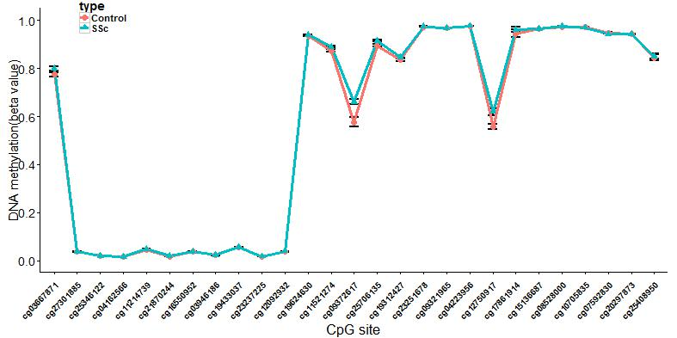
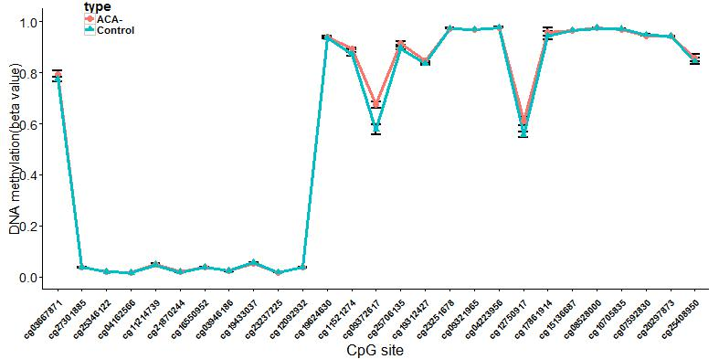
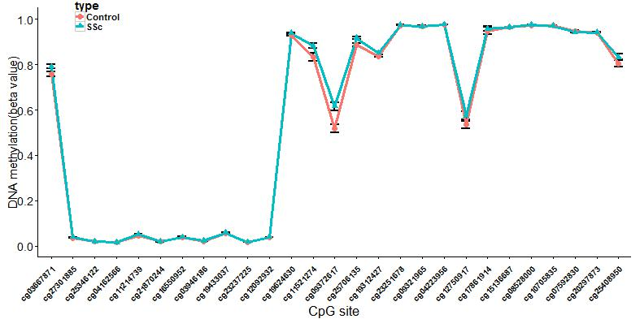
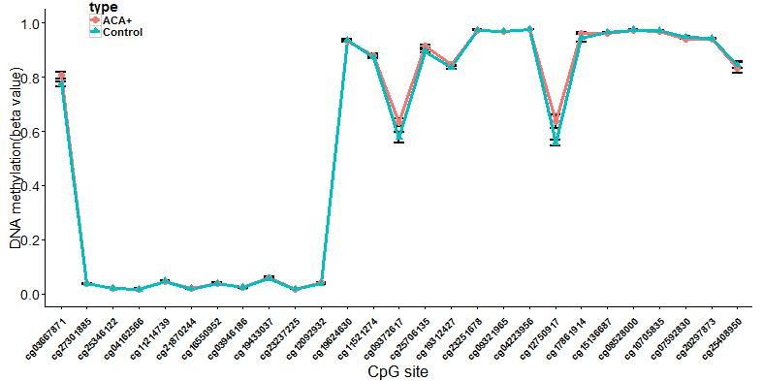
CD4 Total
CD4 ACA- vs. Control
CD8 Total
CD4 ACA+ vs. Control

Slide 14
PRIC285 (Peroxisomal Proliferator-Activated Receptor A-Interacting Complex 285 )/ HELZ2 (Helicase With Zinc Finger 2, Transcriptional Coactivator)
a nuclear transcriptional co-activator for peroxisome proliferator activated receptor alpha.
a member of the DNA2/NAM7 helicase gene family
contains a zinc finger and is a helicase that appears to be part of the peroxisome proliferator activated receptor alpha interacting complex.
Helicase that acts as a transcriptional coactivator for a number of nuclear receptors including PPARA, PPARG, THRA, THRB and RXRA

Slide 15
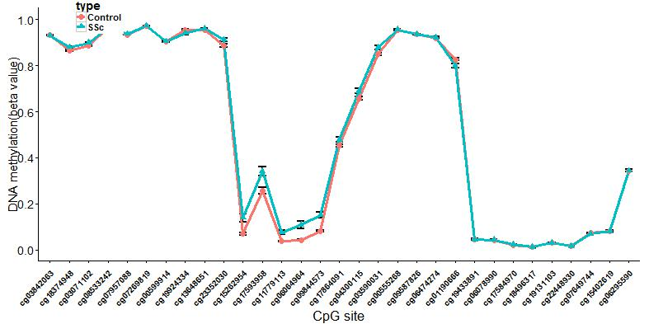
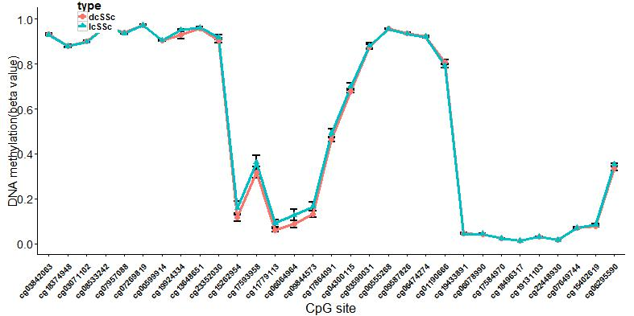
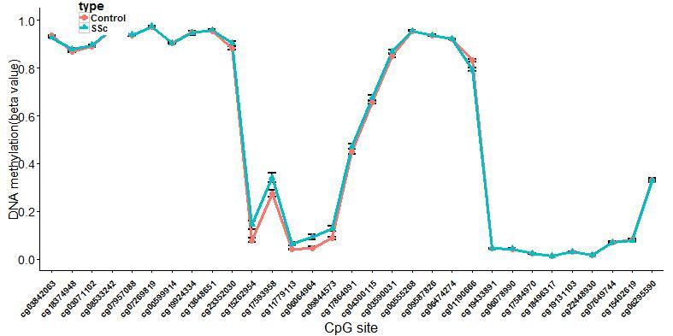
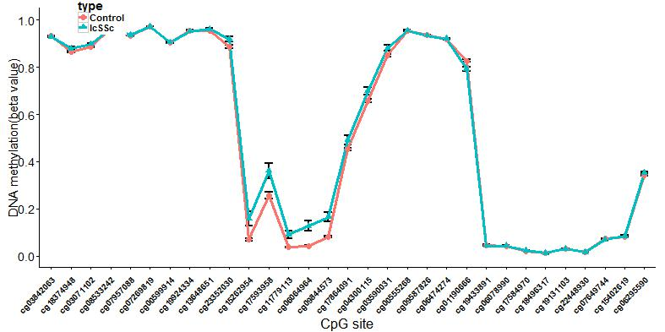
CD4 Total
CD4 dcSSc vs. lcSSc
CD8 Total
CD4 dcSSc vs. Control

Slide 16
SDF4 (Stromal Cell Derived Factor 4)
a stromal cell derived factor that is a member of the CREC protein family.
contains six EF-hand motifs and calcium-binding motifs.
localizes to the Golgi lumen
may be involved in regulating calcium dependent cellular activities in the endoplasmic reticulum lumen or post-ER compartment.
CREC (Cab45/reticulocalbin/ERC45/calumenin)
Notes:
基质细胞因子4
Isoform 5 may be involved in the exocytosis of zymogens by pancreatic acini

Slide 17
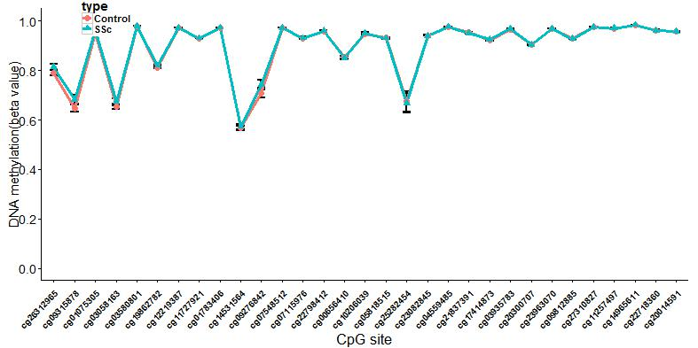
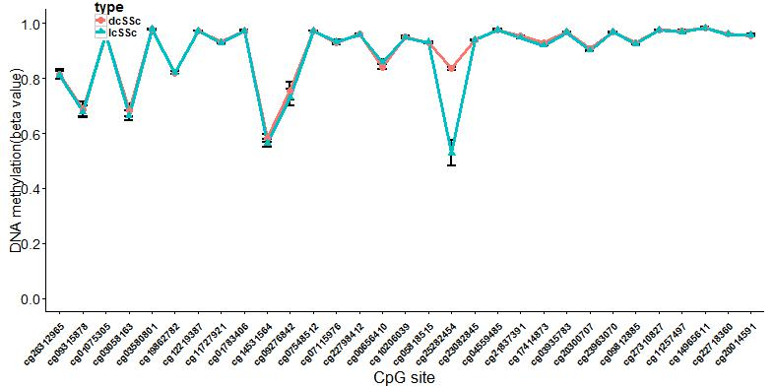
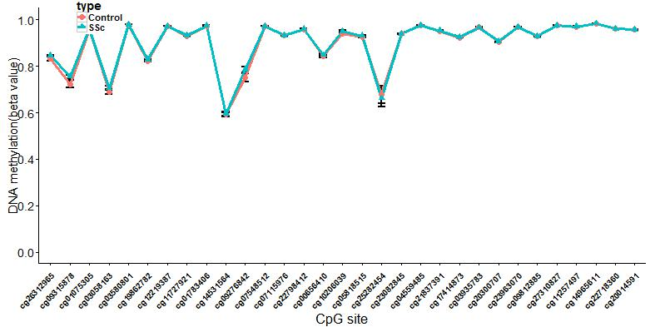
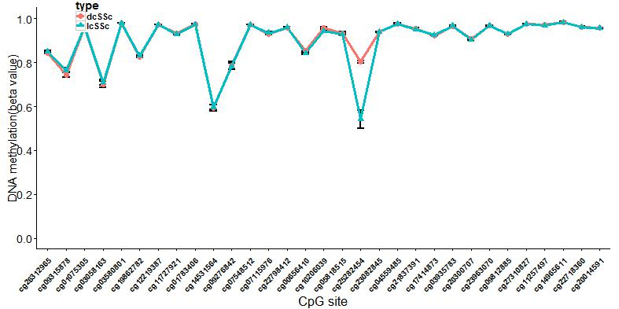
CD4 Total
CD4 dcSSc vs. lcSSc
CD8 Total
CD8 dcSSc vs. lcSSc

Slide 18
SMAD3 (Mothers Against DPP Homolog 3)
SMAD proteins are signal transducers and transcriptional modulators that mediate multiple signaling pathways.
Can activate by TGF-beta (transforming growth factor) and activin type 1 receptor kinases.

Slide 19
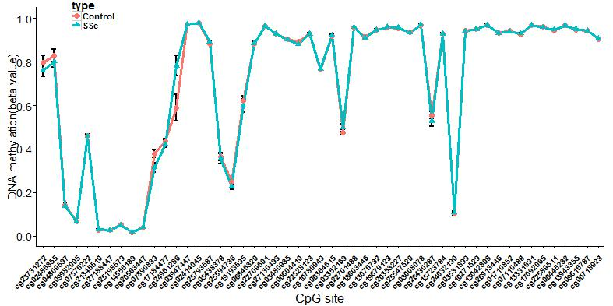
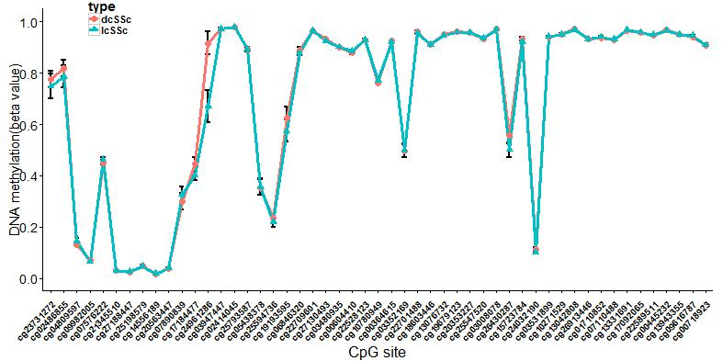
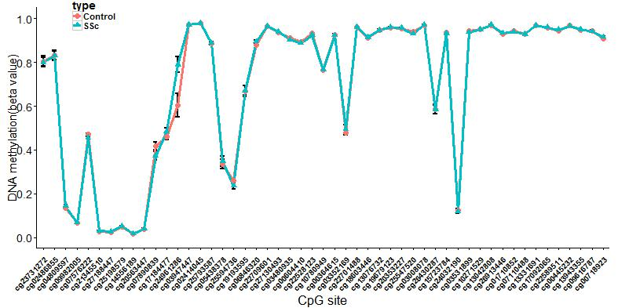
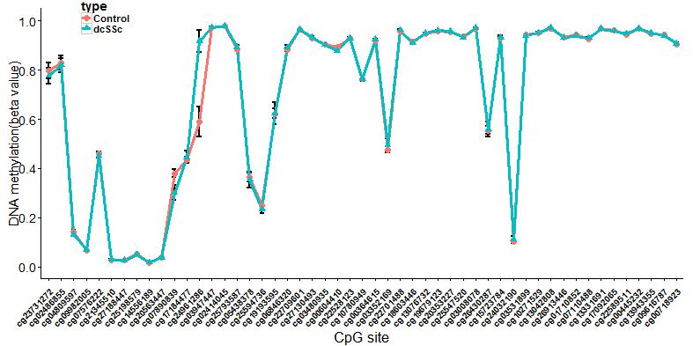
CD4 Total
CD4 dcSSc vs. lcSSc
CD8 Total
CD4 dcSSc vs. Control

Slide 20
TLR1 (Toll-Like Receptor 1)
a member of the Toll-like receptor (TLR) family which plays a fundamental role in pathogen recognition and activation of innate immunity.
Participates in the innate immune response to microbial agents.
Specifically recognizes diacylated and triacylated lipopeptides.
Cooperates with TLR2 to mediate the innate immune response to bacterial lipoproteins or lipopeptides.
Acts via MYD88 and TRAF6, leading to NF-kappa-B activation, cytokine secretion and the inflammatory response

Slide 21
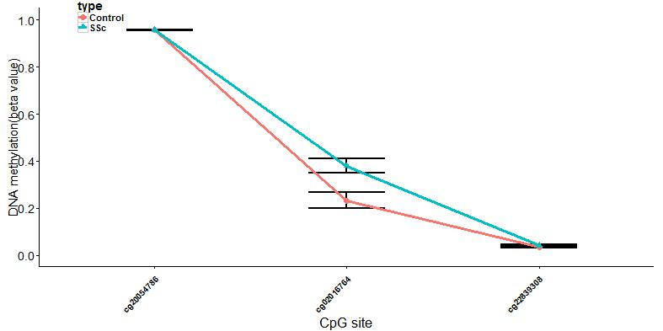
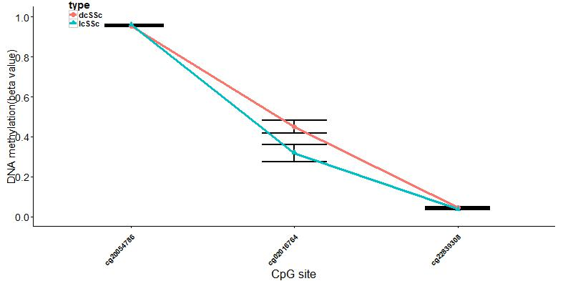
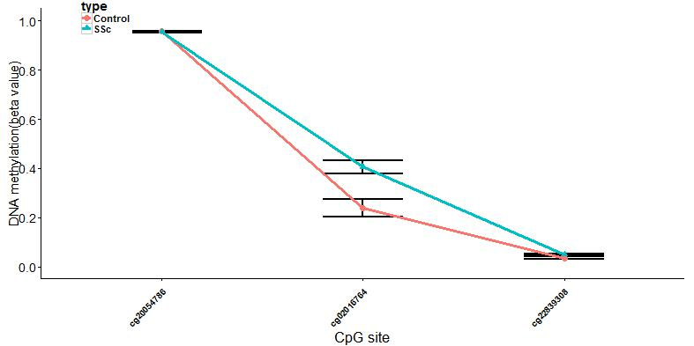
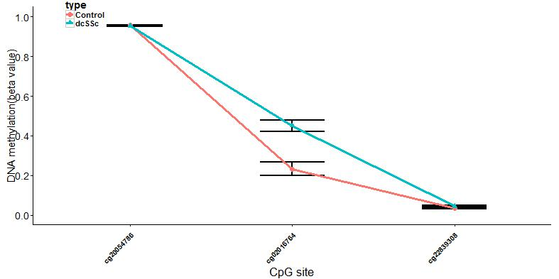
CD4 Total
CD4 dcSSc vs. lcSSc
CD8 Total
CD4 dcSSc vs. Control
Notes:
In 5’utr region

Slide 22
CCDC85C (Coiled-coil domain containing 85c)
play an important role in cortical（外皮层）development, especially in the maintenance of radial glia (神经胶质细胞)
cerebral cortex development
PAPER: Analysis of Autoantibody Profiles in Osteoarthritis
Notes:
自身抗体产生有关

Slide 23
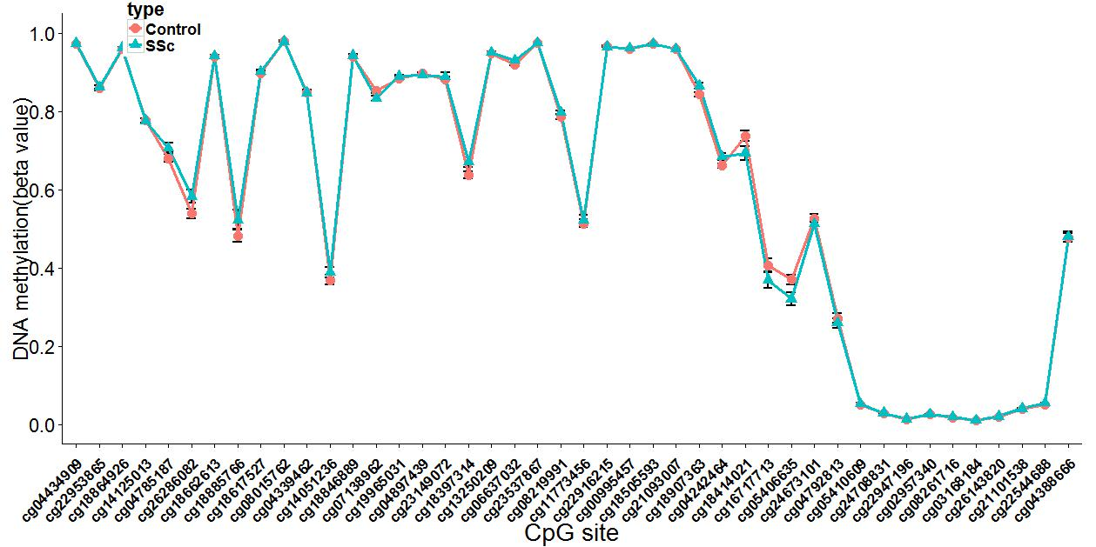
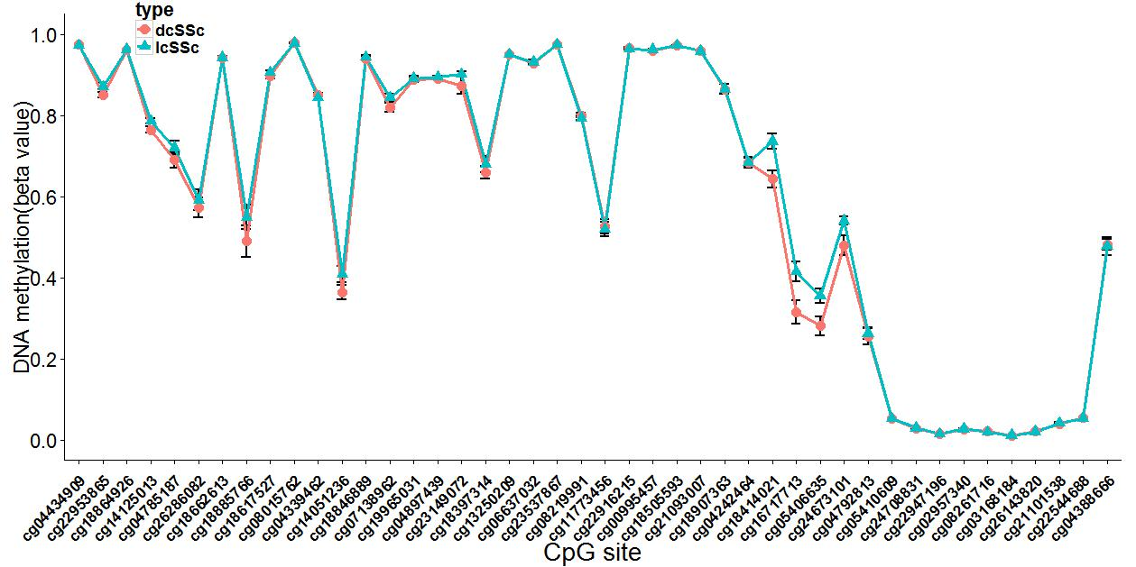

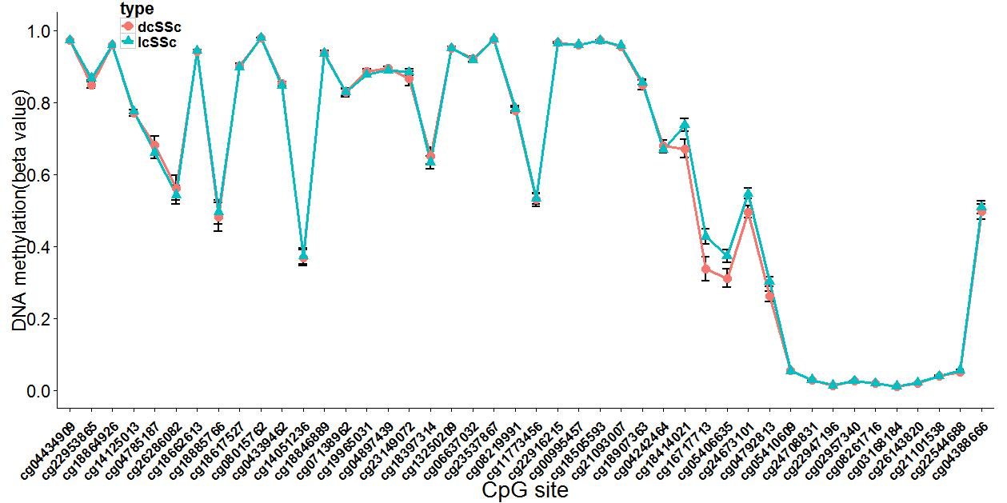
CD4 Total
CD4 dcSSc vs. lcSSc
CD8 Total
CD8 dcSSc vs. lcSSc

Slide 24
COLEC11(Collectin Sub-Family Member 11)
a member of the collectin family of C-type lectins that possess collagen-like sequences and carbohydrate recognition domains.
Collectins are secreted proteins that play important roles in the innate immune system by binding to carbohydrate antigens on microorganisms, facilitating their recognition and removal.
binds to various sugars including fucose and mannose. Has a higher affinity for fucose compared to mannose. Does not bind to glucose, N-acetylglucosamine and N-acetylgalactosamine.
Also binds lipopolysaccharides (LPS).
Involved in fundamental development serving as a guidance cue for neural crest cell migration (By similarity)
Mutations in this gene are a cause of 3MC syndrome-2.
Notes:
3MC syndrome has been proposed as a unifying term encompassing the overlapping Carnevale, Mingarelli, Malpuech and Michels syndromes. These rare autosomal recessive disorders exhibit a spectrum of developmental features, including characteristic facial dysmorphism, cleft lip and/or palate, craniosynostosis, learning disability and genital, limb and vesicorenal anomalies. 胶原凝集素 lectin：凝集素

Slide 25
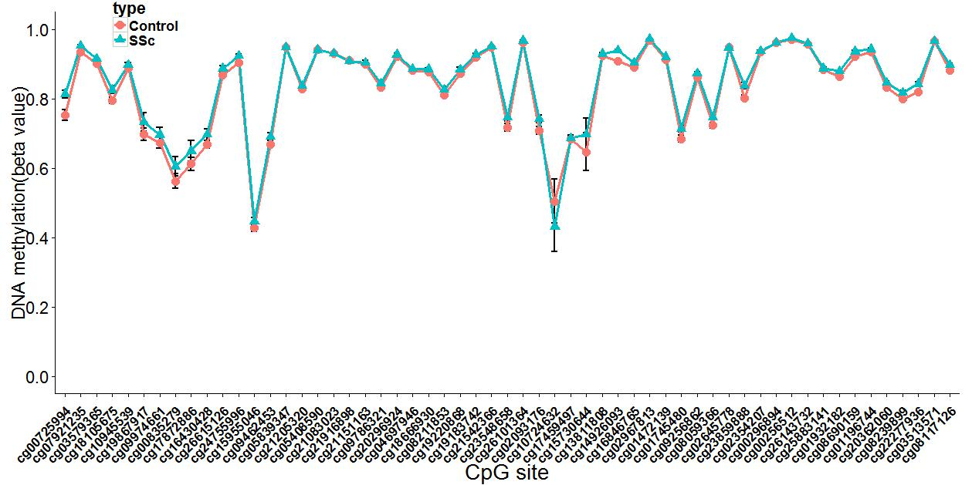
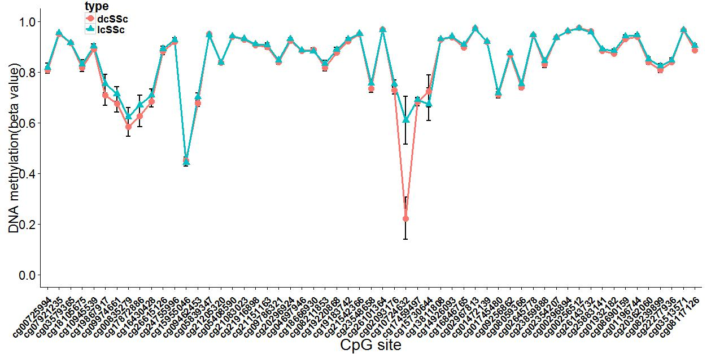
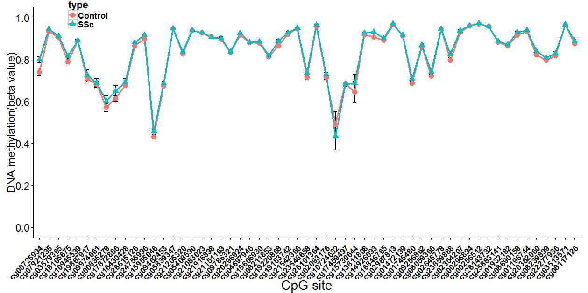
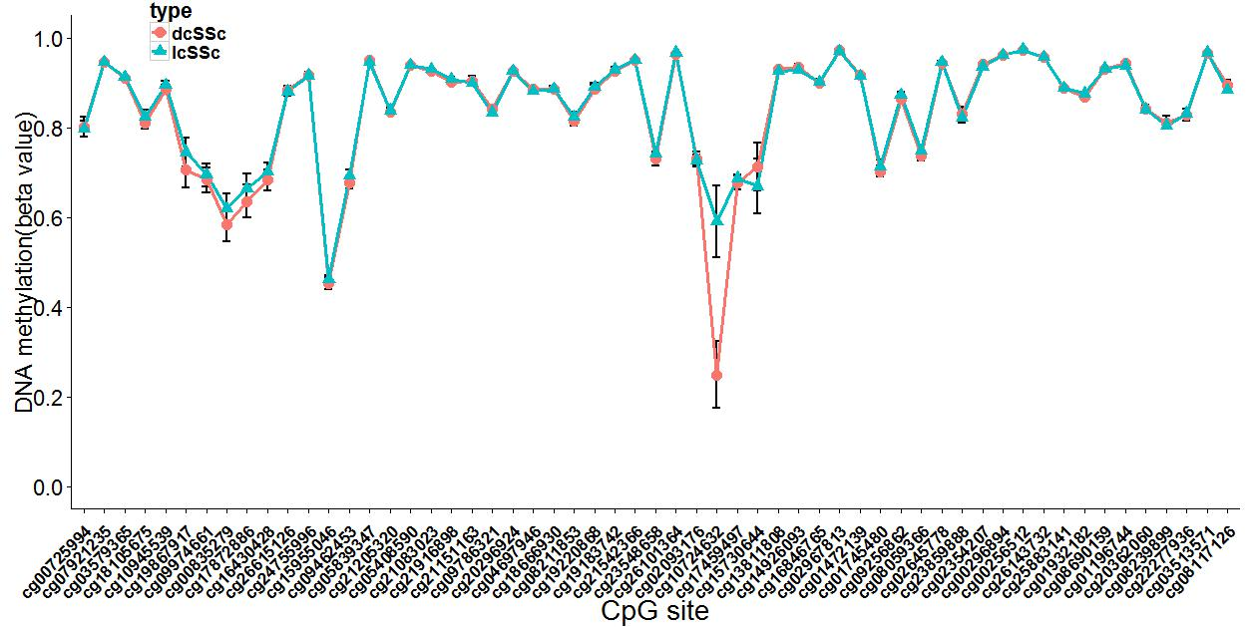
CD4 Total
CD4 dcSSc vs. lcSSc
CD8 Total
CD8 dcSSc vs. lcSSc

Slide 26
COX7A2 (Cytochrome C Oxidase Subunit VIIa Polypeptide 2)
one of the nuclear-coded polypeptide chains of cytochrome c oxidase
Cytochrome c oxidase, the terminal component of the mitochondrial respiratory chain, catalyzes the electron transfer from reduced cytochrome c to oxygen.
Cytochrome c oxidase is a heteromeric complex consisting of three catalytic subunits encoded by mitochondrial genes, and multiple structural subunits encoded by nuclear genes. The mitochondrially-encoded subunits function in electron transfer, while the nuclear-encoded subunits may function in the regulation and assembly of the complex.
Diseases associated with COX7A2 include barrett's adenocarcinoma
Notes:
prostate cancer, influence AIDS progression COX7A2, TAGLN2 and S100-A10 as novel prognostic markers in Barrett's adenocarcinoma
Related pseudogenes have been identified on chromosomes 4 and 14
This nuclear gene encodes polypeptide 2 (liver isoform) of subunit VIIa, with this polypeptide being present in both muscle and non-muscle tissues. In addition to polypeptide 2, subunit VIIa includes polypeptide 1 (muscle isoform), which is present only in muscle tissues, and a related protein, which is present in all tissues.

Slide 27
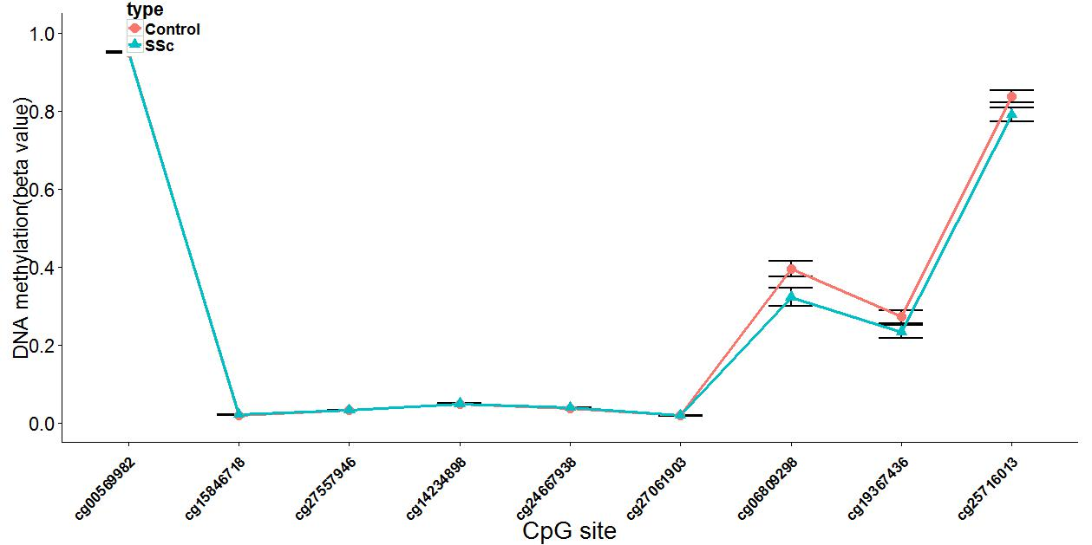
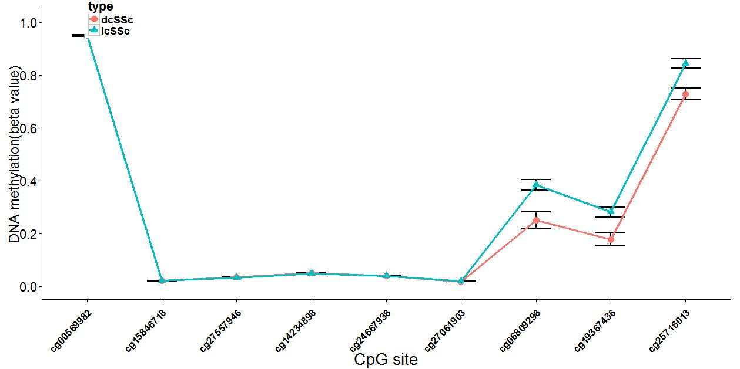
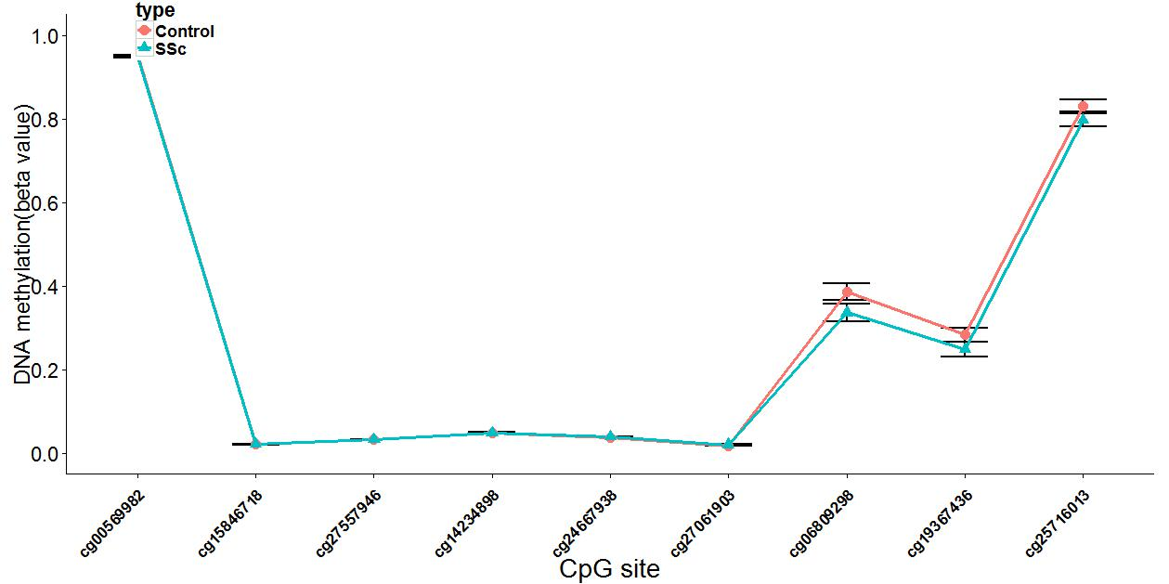
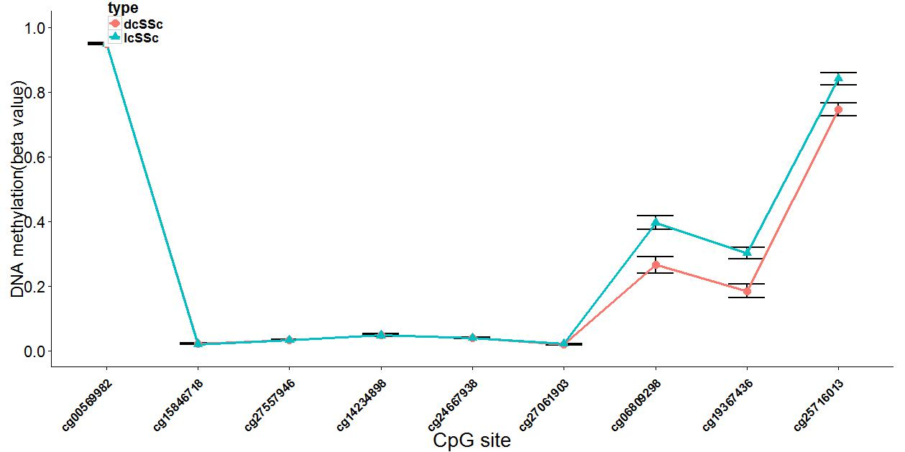
CD4 Total
CD4 dcSSc vs. lcSSc
CD8 Total
CD8 dcSSc vs. lcSSc

Slide 28
EIF2AK2 (Eukaryotic Translation Initiation Factor 2-Alpha Kinase 2)
a serine/threonine protein kinase that is activated by autophosphorylation after binding to dsRNA
IFN-induced dsRNA-dependent serine/threonine-protein kinase which plays a key role in the innate immune response to viral infection and is also involved in the regulation of signal transduction, apoptosis, cell proliferation and differentiation.
Plays a role in the regulation of the cytoskeleton by binding to gelsolin (GSN), sequestering the protein in an inactive conformation away from actin.
Notes:
gelsolin (GSN): 凝溶胶蛋白 Exerts its antiviral activity on a wide range of DNA and RNA viruses including hepatitis C virus (HCV), hepatitis B virus (HBV), measles virus (MV) and herpes simplex virus 1 (HHV-1).
Diseases associated with EIF2AK2 include fanconi anemia, complementation group c and birt-hogg-dube syndrome

Slide 29
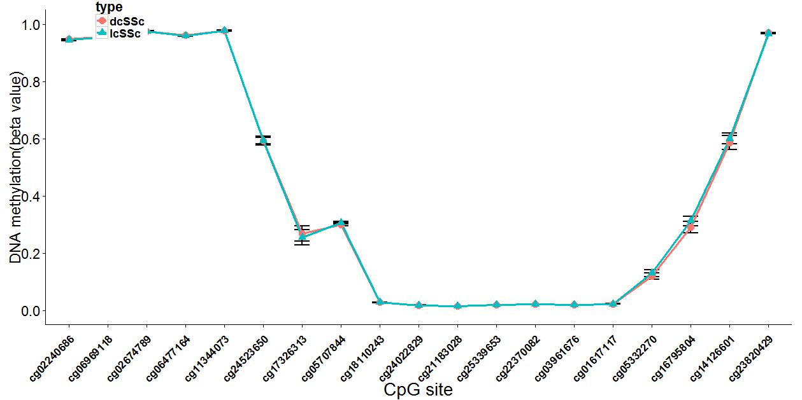
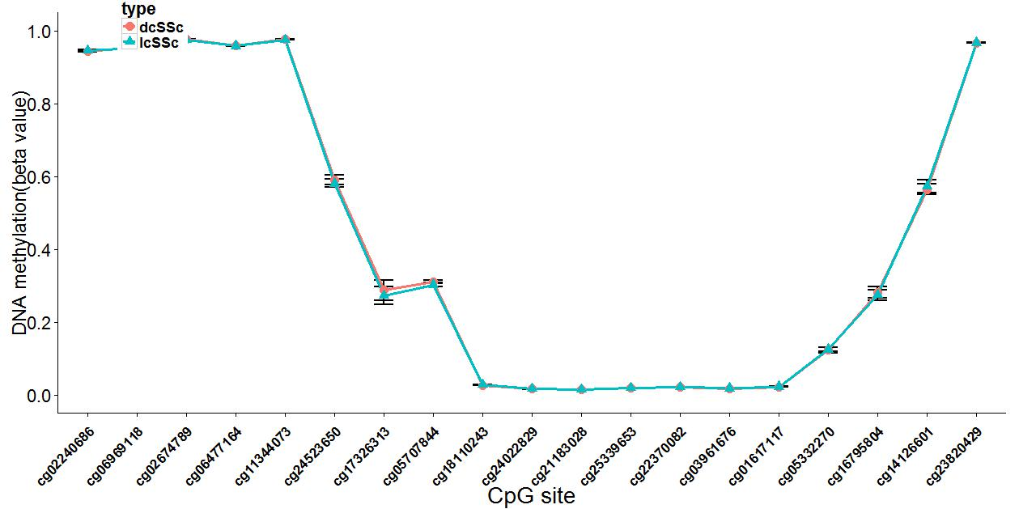
CD4 Total
CD4 dcSSc vs. lcSSc
CD8 Total
CD4 ACA+ vs. ACA-

Slide 30
GFPT2 (Glutamine-Fructose-6-Phosphate Transaminase 2)
L-glutamine + D-fructose 6-phosphate GFPT2 L-glutamate + D-glucosamine 6-phosphate
Controls the flux of glucose into the hexosamine pathway.
Most likely involved in regulating the availability of precursors for N- and O-linked glycosylation of proteins
GO annotations related to this gene include carbohydrate binding and glutamine-fructose-6-phosphate transaminase (isomerizing) activity

Slide 31
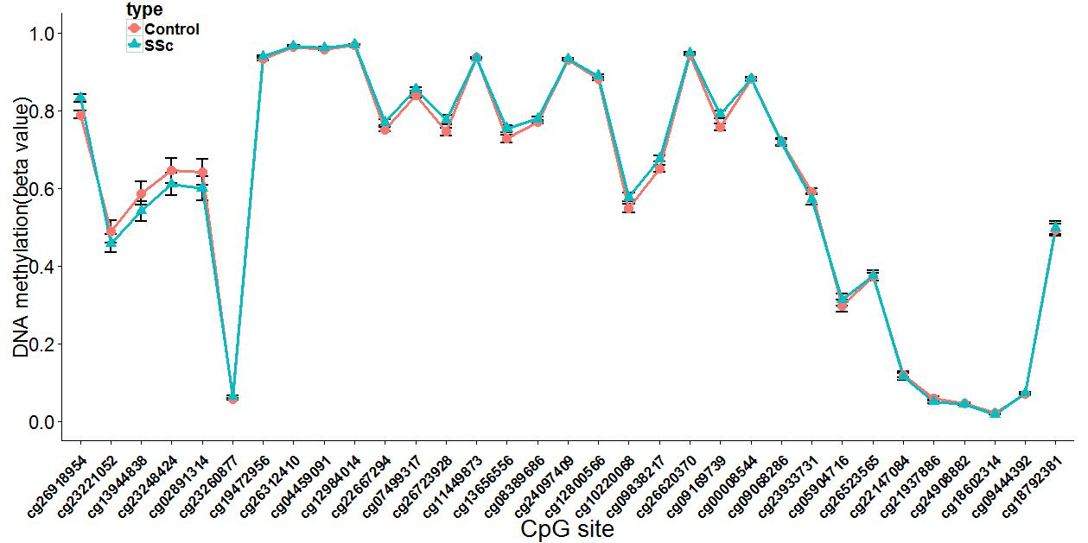
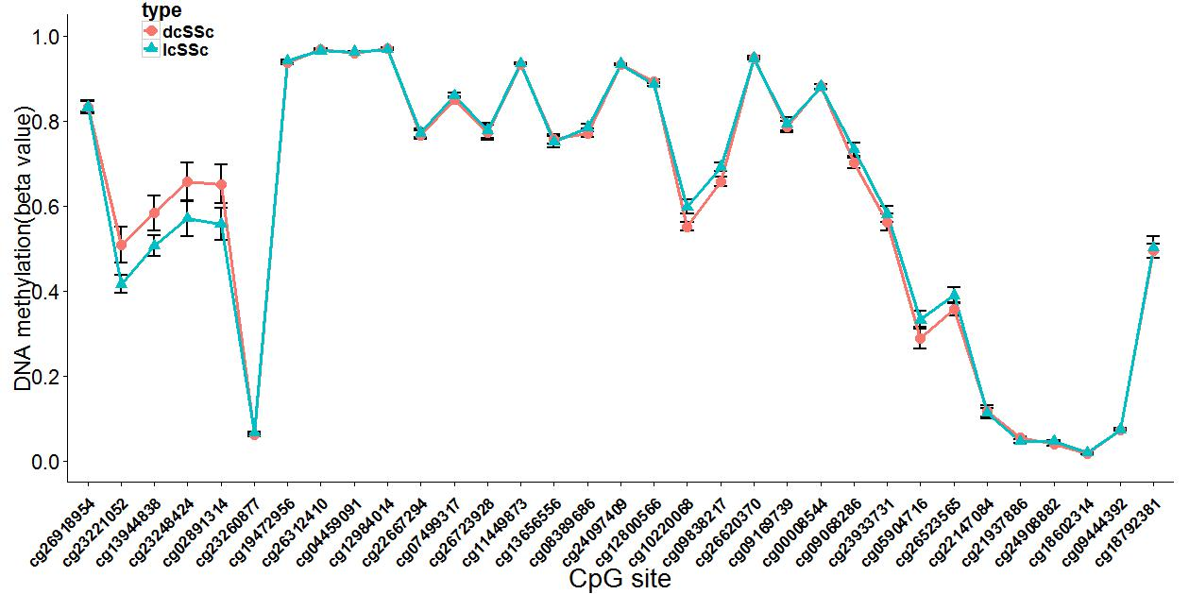


CD4 Total
CD4 dcSSc vs. lcSSc
CD8 Total
CD4 ACA+ vs. ACA-

Slide 32
HLA-DPB1(HLA Class II Histocompatibility Antigen, DP(W4) Beta Chain)
the HLA class II beta chain paralogues. This class II molecule is a heterodimer consisting of an alpha (DPA) and a beta chain (DPB), both anchored in the membrane.
It plays a central role in the immune system by presenting peptides derived from extracellular proteins.
Notes:
Class II molecules are expressed in antigen presenting cells (APC: B lymphocytes, dendritic cells, macrophages). The beta chain is approximately 26-28 kDa and its gene contains 6 exons.
Diseases associated with HLA-DPB1 include chronic berylliosis and wegener granulomatosis. Among its related pathways are Class I MHC mediated antigen processing and presentation and Epstein-Barr virus infection.

Slide 33




CD4 Total
CD4 ATA- vs. Control
CD8 Total
CD4 ATA+ vs. ATA-

Slide 34
HOOK2(Hook Microtubule-Tethering Protein 2)
cytosolic coiled-coil proteins that contain conserved N-terminal domains, which attach to microtubules, and more divergent C-terminal domains, which mediate binding to organelles.
Contributes to the establishment and maintenance of centrosome function.
May function in the positioning or formation of aggresomes, which are pericentriolar accumulations of misfolded proteins, proteasomes and chaperones
Notes:
Among its related pathways are Metabolism

Slide 35


CD4 Total
CD8 Total

Slide 36
IFI44L (Interferon-Induced Protein 44-Like)
Exhibits a low antiviral activity against hepatitis C virus
By type I interferons

Slide 37


CD4 Total
CD8 Total

Slide 38
IFITM1 (Interferon Induced Transmembrane Protein 1)
IFN-induced antiviral protein which inhibits the entry of viruses to the host cell cytoplasm, permitting endocytosis, but preventing subsequent viral fusion and release of viral contents into the cytosol.
Plays a key role in the antiproliferative action of IFN-gamma either by inhibiting the ERK activation or by arresting cell growth in G1 phase in a p53-dependent manner.
Also implicated in cell adhesion and control of cell growth and migration.
Acts as a positive regulator of osteoblast differentiation.
Notes:
Active against multiple viruses, including influenza A virus, SARS coronavirus (SARS-CoV), Marburg virus (MARV), Ebola virus (EBOV), Dengue virus (DNV), West Nile virus (WNV), human immunodeficiency virus type 1 (HIV-1) and hepatitis C virus (HCV).
Can inhibit: influenza virus hemagglutinin protein-mediated viral entry, MARV and EBOV GP1,2-mediated viral entry and SARS-CoV S protein-mediated viral entry.
Diseases associated with IFITM1 include rift valley fever and esophageal cancer. Among its related pathways are Class I MHC mediated antigen processing and presentation and Interferon Signaling.

Slide 39




CD4 Total
CD4 lcSSc vs. Control
CD8 Total
CD4 ATA+ vs. Control

Slide 40
IL17RA (Interleukin 17 Receptor A)
Receptor for IL17A, IL17F and, in dimer with IL17RE, for IL17C.
a proinflammatory cytokine secreted by activated T-lymphocytes.
a potent inducer of the maturation of CD34-positive hematopoietic precursors into neutrophils.
Interleukin 17A and its receptor play a pathogenic role in many inflammatory and autoimmune diseases such as rheumatoid arthritis.
Notes:
The transmembrane protein encoded by this gene (interleukin 17A receptor; IL17RA) is a ubiquitous type I membrane glycoprotein that binds with low affinity to interleukin 17A.
Diseases associated with IL17RA include candidiasis, familial, 5, autosomal recessive and chronic mucocutaneous candidiasis.

Slide 41




CD4 Total
CD4 ACA+ vs. ACA-
CD8 Total
CD8 ACA+ vs. ACA-

Slide 42
LAMP3 (Lysosomal-Associated Membrane Protein 3)
play a role in dendritic cell function and in adaptive immunity.
Dendritic cells (DCs) are the most potent antigen-presenting cells. Immature DCs efficiently capture antigens and differentiate into interdigitating dendritic cells (IDCs) in lymphoid tissues that induce primary T-cell responses
its related pathways are Lysosome (溶酶体)

Slide 43


CD4 Total
CD8 Total

Slide 44
MX1 (MX Dynamin-Like GTPase 1)
a guanosine triphosphate (GTP)-metabolizing protein that participates in the cellular antiviral response.
The encoded protein is induced by type I and type II interferons and antagonizes the replication process of several different RNA and DNA viruses.
May also antagonize reoviridae and asfarviridae replication
Enhances ER stress-mediated cell death after influenza virus infection.
May regulate the calcium channel activity
Notes:
Its target viruses include negative-stranded RNA viruses and HBV through binding and inactivation of their ribonucleocapsid.
May regulate the calcium channel activity of TRPCs(canonical transient receptor potential)
Diseases associated with MX1 include subacute sclerosing panencephalitis and rift valley fever.

Slide 45


CD4 Total
CD8 Total

Slide 46
PARP9 (Poly (ADP-Ribose) Polymerase Family, Member 9)
Poly (ADP-ribose) polymerase (PARP) catalyzes the post-translational modification of proteins by the addition of multiple ADP-ribose moieties.
PARP transfers ADP-ribose from nicotinamide dinucleotide (NAD) to glu/asp residues on the substrate protein, and also polymerizes ADP-ribose to form long/branched chain polymers.
In concert with DTX3L plays a role in PARP1-dependent DNA damage repair
its related pathways are Apoptotic Pathways in Synovial Fibroblasts and UVA-Induced MAPK Signaling

Slide 47
DTX3L (Deltex 3 Like; E3 Ubiquitin Ligase)
functions as an E3 ubiquitin ligase
Ubiquitin ligase that mediates monoubiquitination of Lys-91 of histone H4 (H4K91ub1), in response to DNA damage. Protects cells exposed to DNA-damaging agents.
its related pathways are Class I MHC mediated antigen processing and presentation and Class I MHC mediated antigen processing and presentation. GO annotations related to this gene include ubiquitin-protein transferase activity and histone binding.
Notes:
Tumor, SLE等都发现该基因的变化

Slide 48


CD4 Total
CD8 Total

Slide 49
RNF39 (Ring Finger Protein 39)
a similar rat protein suggest that this gene encodes a protein that plays a role in an early phase of synaptic plasticity (突触可塑性)
May play a role in prolonged long term-potentiation (LTP) maintenance
Notes:
长程增强 关节受累可能有关

Slide 50




CD4 Total
CD4 ATA+ vs. Control
CD8 Total
CD4 ACA- vs. Control

Slide 51
TTC39C (Tetratricopeptide Repeat Domain 39C)/ C18orf17
are commonly hypomethylated genes for the cancer types
is differentially regulated under conditions of neurogenic atrophy
Tetratricopeptide(三角形四肽)
Notes:
神经源性萎缩

Slide 52




CD4 Total
CD8 ATA+ vs. ATA-
CD8 Total
CD8 ATA- vs. Control

Slide 53
UPK3B (Uroplakin 3B)
a minor component of the apical plaques of mammalian urothelium that binds and dimerizes with uroplakin-1b (UPK1B; MIM 602380), one of the major conserved urothelium membrane proteins.
Component of the asymmetric unit membrane (AUM);
a highly specialized biomembrane elaborated by terminally differentiated urothelial cells.
May play an important role in AUM-cytoskeleton interaction in terminally differentiated urothelial cells.
It also contributes to the formation of urothelial glycocalyx which may play an important role in preventing bacterial adherence (By similarity)
Notes:
urothelium(尿道膀胱上皮，移形上皮) 肾累积相关

Slide 54




CD4 Total
CD4 ACA+ vs. ACA-
CD8 Total
CD8 ACA+ vs. ACA-

Slide 55
ZBTB46 (Zinc Finger And BTB Domain Containing 46)
Function as a transcriptional repressor for PRDM1(PR Domain Containing 1, With ZNF Domain), a repressor of beta-interferon gene expression.
Transcription of this gene increases upon virus induction.
Drives the maturation of B-lymphocytes into Ig secreting cells.
GO annotations related to this gene include nucleic acid binding. An important paralog of this gene isENSG00000254553.

Slide 56




CD4 Total
CD4 dcSSc vs. lcSSc
CD8 Total
CD8 dcSSc vs. lcSSc

